Slide 1
Indian Trade Analysis and Forecasting
Akarsh Somani (162) and Gaurav Misra (172)

Slide 2
Why Trade Data Analysis and Forecasting
Trade is an economic concept which involves Buying and Selling of the commodities, or exchanging goods and services between needy people. Trade is important in a way that it increases competition and decreases overall world wise cost of a product.
India is only second largest market place (after China) in terms of human resource. Hence many foreign countries exploit this fact, especially China, to sell their products. Hence our Import Trade matters a lot from economic point of view.

Slide 3
Our Motives
Which HS Code involves the most import/export?
From which country we import/export the most?
Forecasting the Indian import/export data to predict what should be our country’s next move?
How our trades are evolving across the years?
Getting Rid of Trade Deficit (Case Study)?

Slide 4
About Data
We have taken the trade dataset from Department of Commerce, Govt. of India website.
Trade Monthly data is available from January, 2006 to January, 2020.
We have total trade amount (Import/Export) for each month which is expressed in million US dollars.
HSCode: - Harmonized System (HS) of tariff nomenclature is an internationally standardized system of names and numbers to classify traded products.
Ex –
1 for Live Animal
95 for Toys, Games and Sports Requisites …

Slide 5
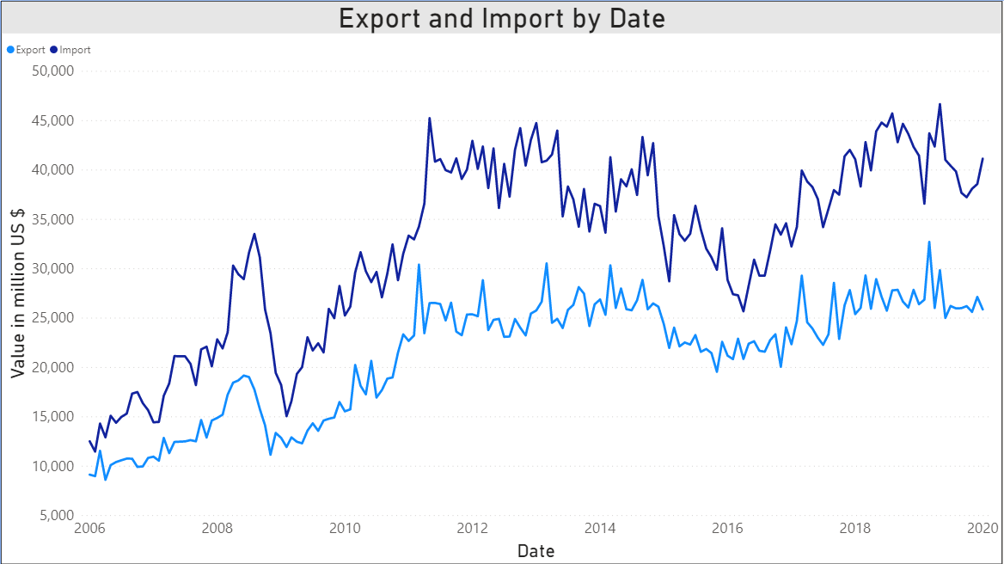
How the Trade Data Looks

Slide 6
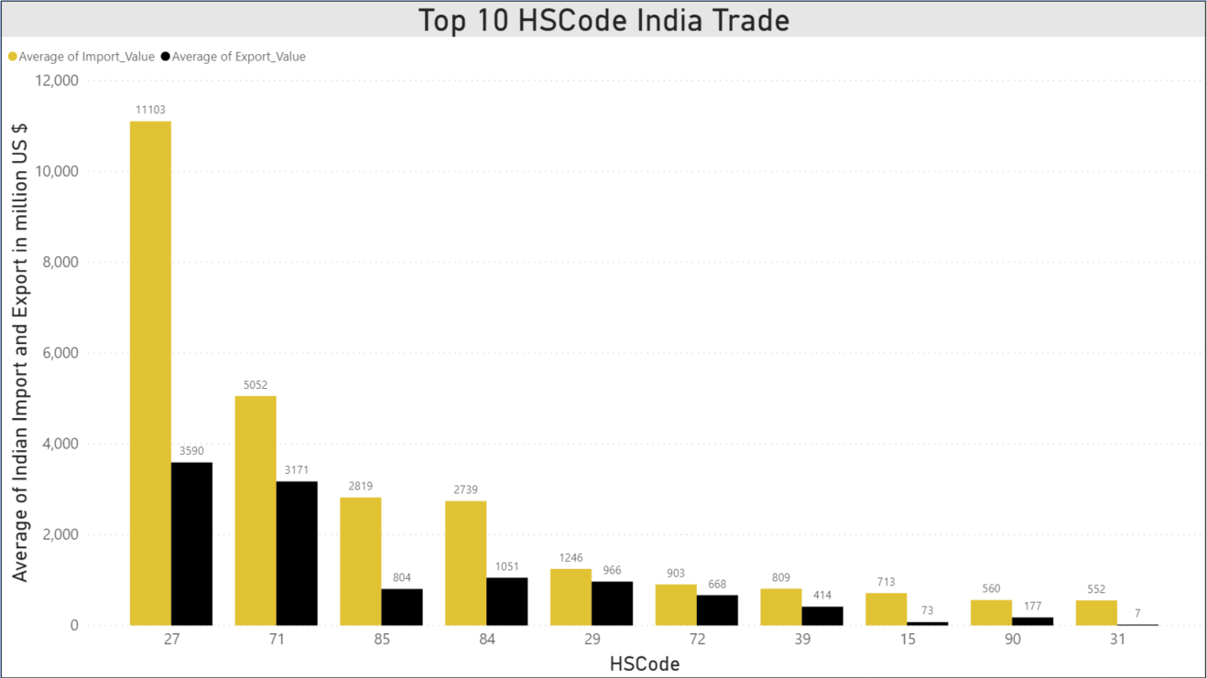
HSCode India trade the most
27 for Mineral Fuels and Mineral Oils and the product of there distillation.
71 for natural or cultured pearls, precious or semiprecious stones, Pre-Metals, Coins
85 for Electrical Machinery and Equipments

Slide 7
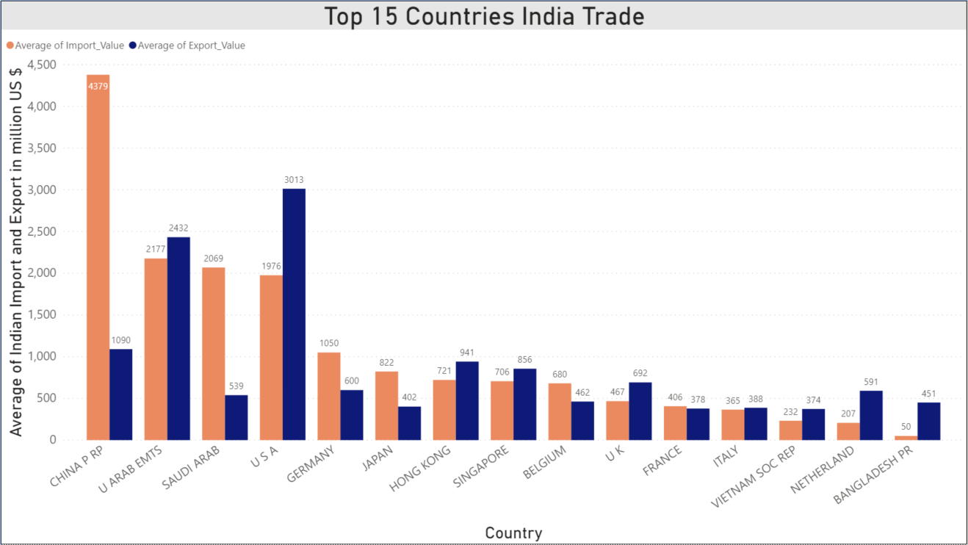
Country From Which India Trade Most
China tops the list with around $4379 million Import followed by United Arab Emirates, Saudi Arab and USA. While USA is top most country to which India exports the most $3013 million followed by UAE, China, Hong Kong and Singapore.

Slide 8
Models we Used for Forecasting
Exponential Smoothing
Auto Regressive Model
Moving Average Model
Holt-Winters Model
ARIMA Additive
ARIMA Multiplicative
ARIMA Seasonal
RNN → LSTM (Long Short Term Memory)

Slide 9
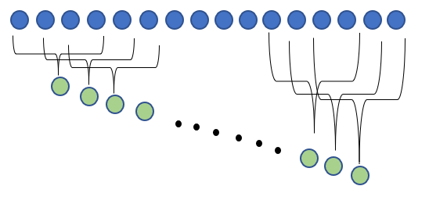
Auto Regressive and Moving Average
AR (Auto Regressive) is used when a value from the time series has dependency on previous values e.g. X_{t} = f(X_{t-1}). The order of an auto-regression is the number of immediately preceding values in the series that are used to forecast the current value e.g. order of 2 denotes that the value X_{t} is dependent on X_{t-1} and X_{t-2}.
MA (Moving Average) is a technique that calculates the overall trend in the dataset. As the name suggest that we go by taking the Average over a fixed rolling size window.

Slide 10
Exponential Smoothing and Holt-Winters
In simple moving average the past observation are equally weighted where as in Exponential Smoothing it exponentially decreases over the time. It has only one smoothing factor.
Holt-Winters is the extension over the simple exponential smoothing method. Here we use triple smoothing with the factor - seasonal period, trend type and seasonal type.

Slide 11
ARIMA – additional and multiplicative
ARIMA stands for Autoregressive Integrated Moving Average which is a combination of three terms –
AR – Auto Regressive
I – Integrated (difference between current values and the previous values)
MA – Moving Average
ARIMA additive –
Additive Time Series = Trend + Seasonality + Randomness
ARIMA multiplicative –
Multiplicative Time Series = Trend * Seasonality * Randomness

Slide 12
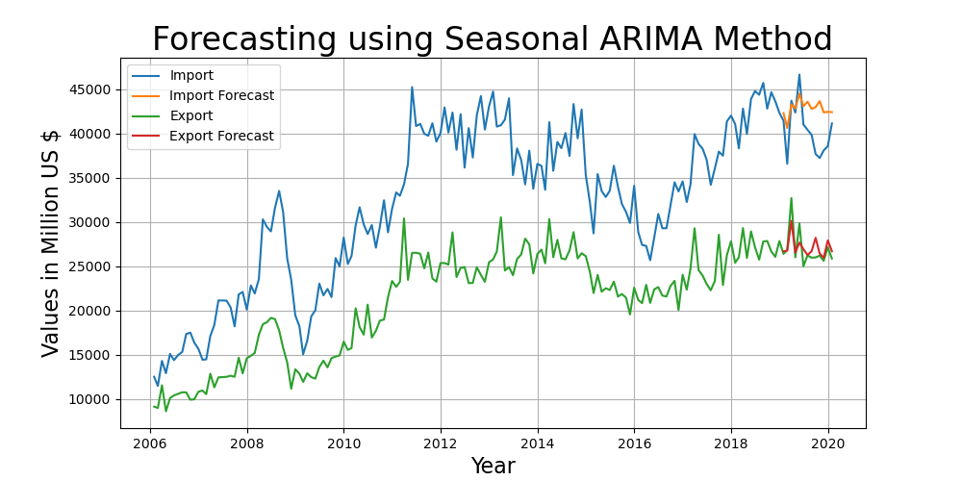
Seasonal ARIMA
Seasonal ARIMA here is ARIMA Multiplicative method with a seasonality factor m. Here we have chosen the multiplicative factor of 12 as ours is a monthly data.
This is one of the best model that we have tried and as can be seen the prediction is very close to actual.
RMSE Import/Export - 3391.32, 1310.58

Slide 13
LSTM

